Slide 1


TEAM BASSH
UNISYNC
Meet the Team:
Bishakha
Anirudh
Shivam
Shivansh
Harsh
Notes:
• This slide introduces our team, TEAM BASSH. • It lists the five members of our team - Bishakha, Anirudh, Shivam, Harsh, and Shivansh. • I'm excited for you all to get to know each of these talented individuals and the unique strengths they bring to our team. • As you can see, we have a diverse group with a range of skills and backgrounds, which makes us a well-rounded team. • I encourage you to take a moment to familiarize yourselves with the team members, as you'll be hearing more about their contributions throughout the presentation.

Slide 2

Smart College: Reimagine Campus. Redefine Education.
Welcome to the Smart College Management System, an AI-powered platform designed to revolutionize campus operations. Our cloud-integrated solution creates a unified, intelligent, and scalable ecosystem for colleges and universities, enhancing every facet of campus life from academics to administration. Experience the future of education management with Smart College.

Slide 3

The Problem: Siloed Systems, Strained Resources
Fragmented Data Across Multiple Platforms
Colleges rely on various disconnected systems for student records, faculty management, and resources, leading to inefficiencies and data inconsistencies.
Inefficient Resource Utilization
Without a unified platform, allocating faculty, classrooms, and learning resources becomes time-consuming and prone to mismanagement.
Lack of Real-Time Monitoring & Insights
Delayed data updates affect crucial decisions related to student enrollment, attendance, and academic performance, reducing overall efficiency.

Slide 4

Our Solution: The Smart College Ecosystem
Centralized Data Management
Integrates all academic and administrative operations into a single platform for seamless access and efficient workflow.
Automated Attendance & Performance Tracking
Uses AI-powered analytics to monitor attendance and academic trends, enabling early intervention for student success.
Effortless Faculty & Resource Allocation
Dynamically assigns faculty, classrooms, and learning materials based on real-time requirements, reducing scheduling conflicts.
Unified, Intelligent, Scalable. Cloud-integrated for accessibility.

Slide 5
User Roles & Authentication
Implement JWT-based authentication for Admin, Faculty, and Students.
Student Enrollment & Record Management
Use MongoDB to store student profiles and academic history.
Course & Faculty Allocation
Assign faculty to courses dynamically via an admin panel.
Attendance Tracking System
Faculty marks attendance through a digital interface, stored in MongoDB.
Exam & Grade Management
A grading system where faculty can input marks and students can view results.
Notification System
Real-time notifications for announcements using WebSockets/Firebase.

Slide 6
AI-based Attendance Prediction
Use predictive analytics to alert students at risk of low attendance.
Voice Assistant for Timetable Queries
Integrate a chatbot with voice recognition for instant timetable access.

Slide 7





AI-Powered Features: Intelligence at Every Level
Predictive Analytics
Automated Resource Optimization
Personalized Learning Paths
Increase Enrollment Projections by 15%.
Reduce Energy Costs by 20%.
Boost Student Retention by 10%.
Smart Security & Access Control
our project uses the power of AI CHATBOT to provide intelligent insights and automation across all departments. Predictive analytics accurately forecast enrollment, while automated resource optimization slashes costs. Personalized learning paths enhance student engagement and retention, creating a safer, more sustainable campus.

Slide 8
Scalability & Integration: Ready for Any Campus
Modular design adapts to unique needs
99.9% uptime and data redundancy
The Smart College platform is designed to be flexible, adapting to the specific needs and structure of each institution. This modular approach ensures a tailored fit, maximizing effectiveness and minimizing disruption.
We guarantee 99.9% uptime and robust data redundancy, ensuring uninterrupted access and the highest levels of data security and reliability for your campus operations.
Seamless integration with existing infrastructure
Our system integrates smoothly with existing technology, avoiding costly overhauls and ensuring a seamless transition for staff and students alike.

Slide 9

The Impact: Transforming Campus Life
40%
Reduced administrative overhead
25%
Increased student satisfaction
15%
Improved graduation rates
10%
Decreased carbon footprint
With Smart College, institutions experience transformative improvements across key metrics. By reducing administrative overhead, increasing student satisfaction, boosting graduation rates, and decreasing carbon footprint, Smart College delivers tangible, measurable results. For example, at State College, Smart College helped reduce administrative costs by 30% and boosted student satisfaction scores by 20%.

Slide 10
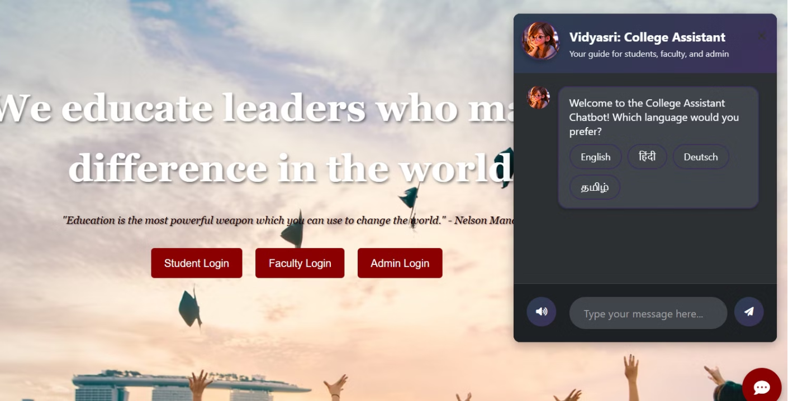
Our multilingual AI chatbot Helping the student.
MULTILINGUAL AI-CHATBOT

Slide 11
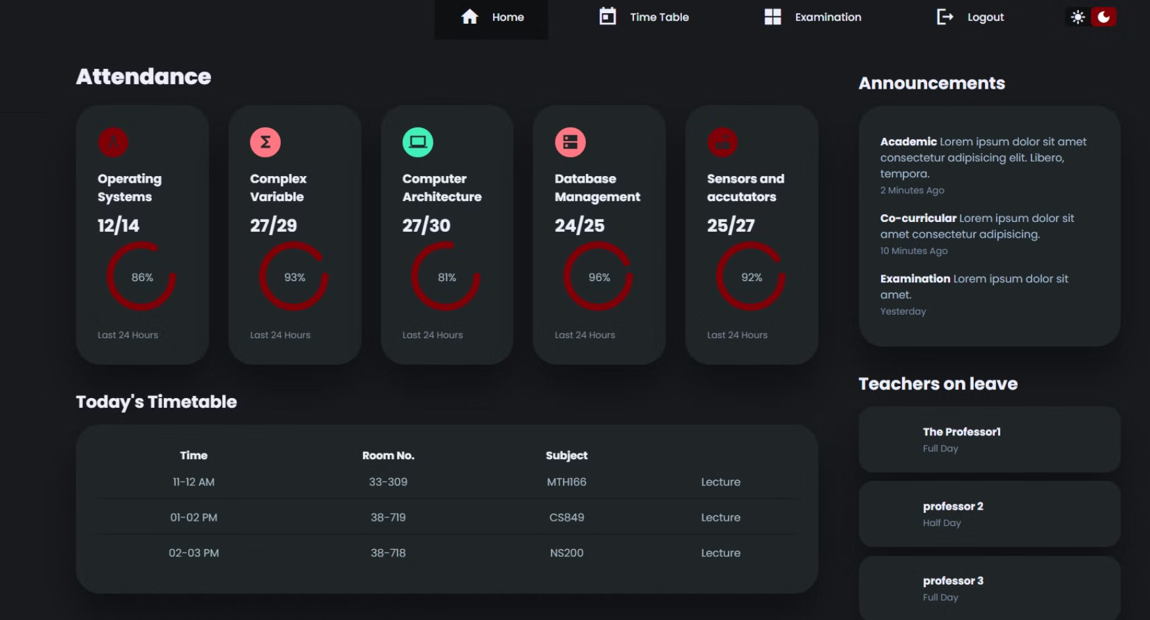
STUDENT DASHBOARD

Slide 12
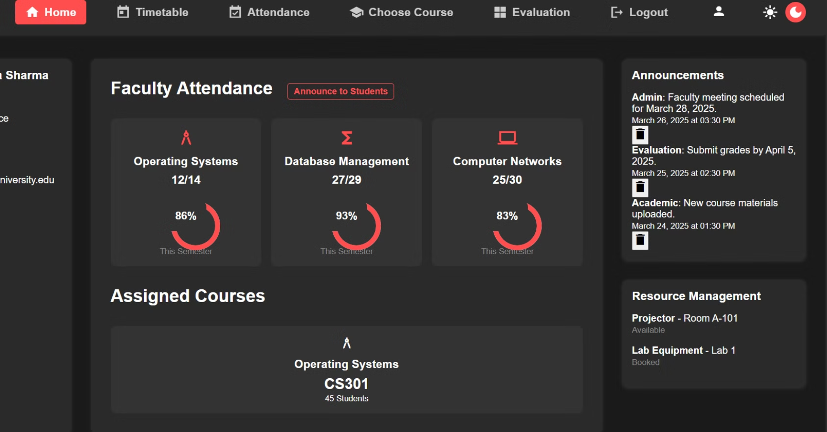
FACULTY DASHBOARD

Slide 13
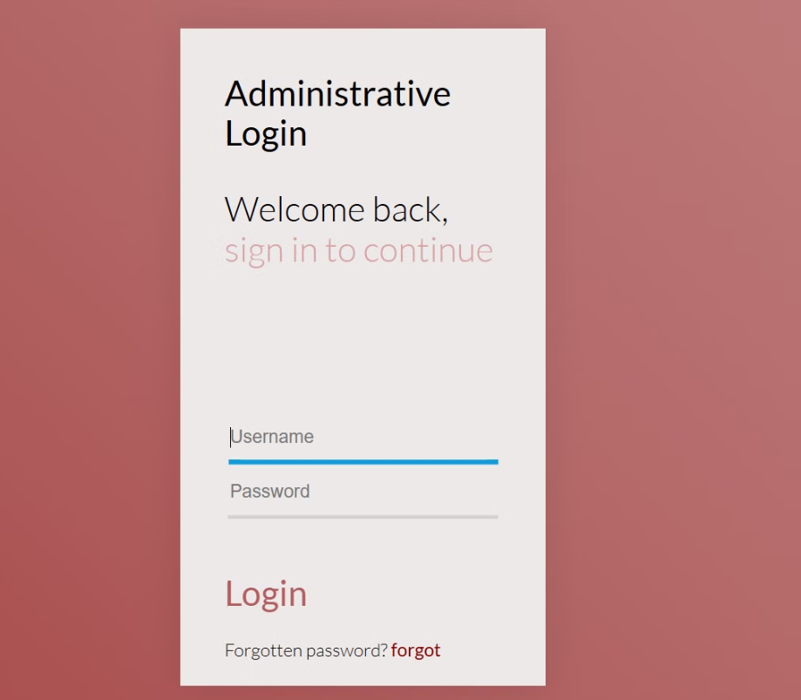
LOGIN PAGE

Slide 14
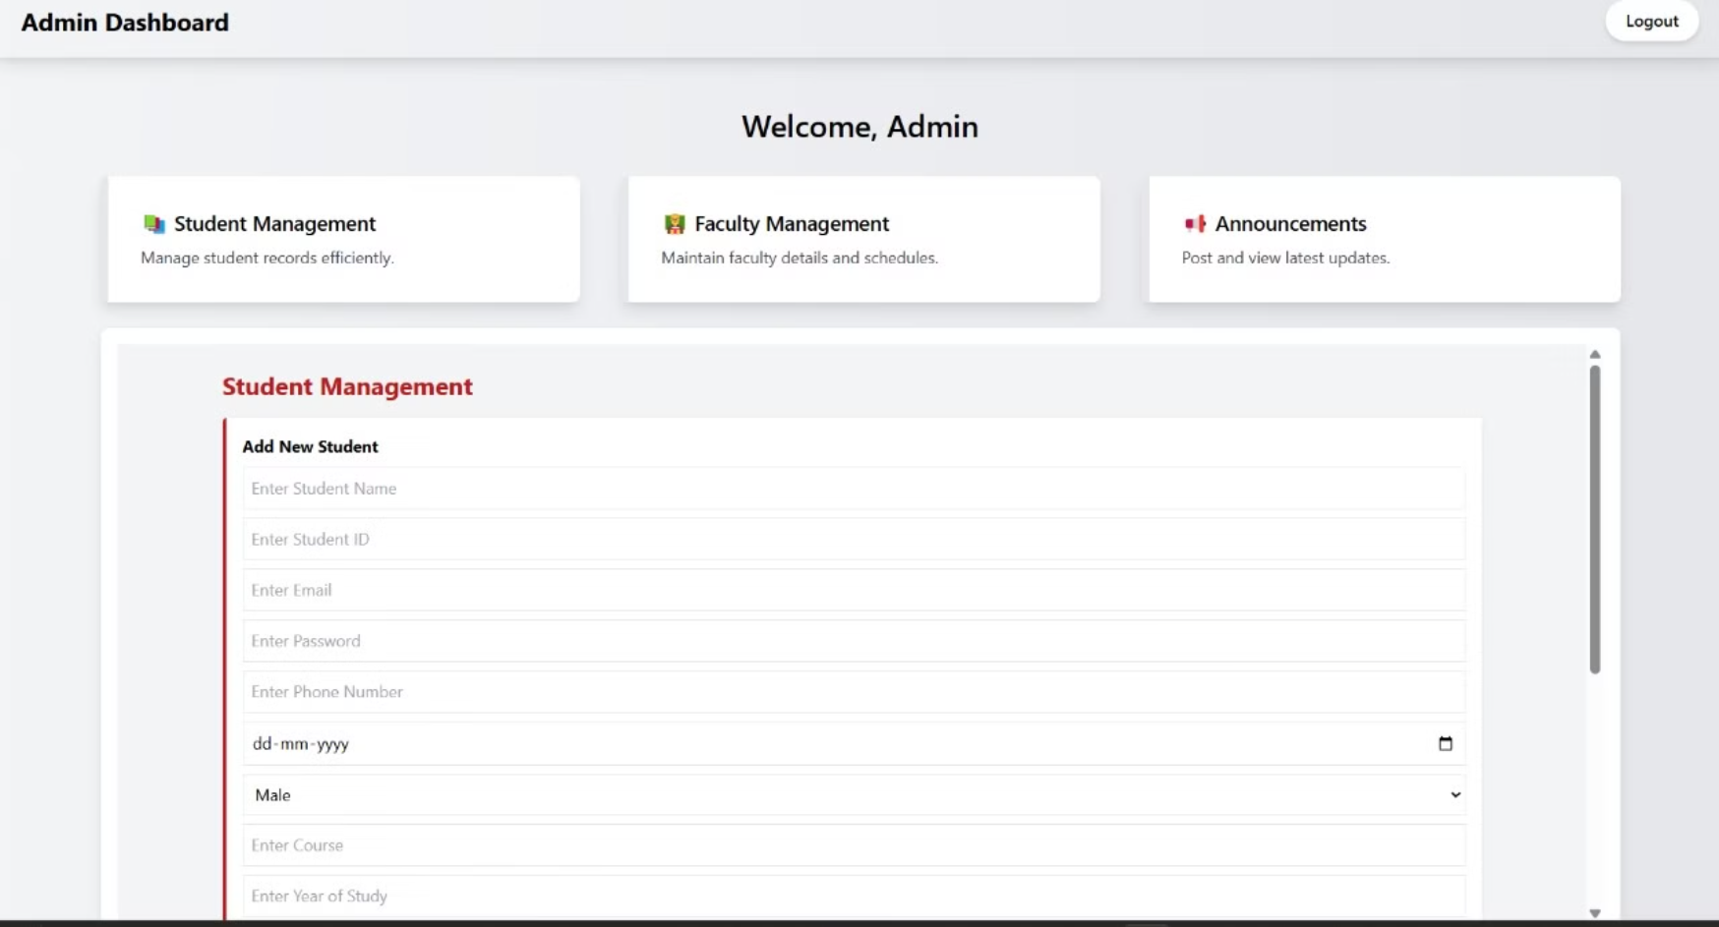
ADMIN DASHBOARD

Slide 15
THANK YOU

